Slide 1
Graphs Topic 21
" Hopefully, you've played around a bit with The Oracle of Bacon at Virginia and discovered how few steps are necessary to link just about anybody who has ever been in a movie to Kevin Bacon, but could there be some actor or actress who is even closer to the center of the Hollywood universe?.
By processing all of the almost half of a million people in the Internet Movie Database I discovered that there are currently 1160 people who are better centers than Kevin Bacon! … By computing the average of these numbers we see that the average (Sean) Connery Number is about 2.682 making Connery a better center than Bacon"
-Who is the Center of the Hollywood Universe?, University of Virginia
That was in 2001. In 2013 Harvey Keitel has become the center of the Hollywood Universe. Connery is 136th. Bacon has moved up to 370^{th.}

Slide 2
An Early Problem in Graph Theory
Leonhard Euler (1707 - 1783)
One of the first mathematicians to study graphs
The Seven Bridges of Konigsberg Problem
Konigsberg now called Kaliningrad
A puzzle for the residents of the city
The river Pregel flows through the city
7 bridges cross the river
Can you cross all bridges while crossing each bridge only once?

Slide 3
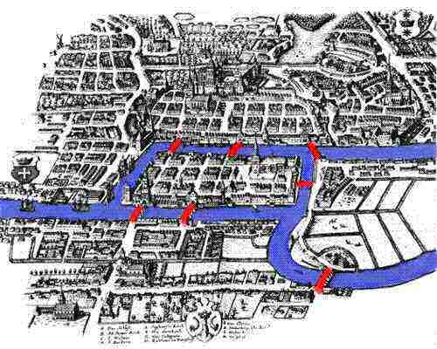
Konigsberg and the River Pregel

Slide 4
Clicker Question 1
How many solutions does the Seven Bridges of Konigsberg Problem have?
0
1
2
3
>= 4

Slide 5
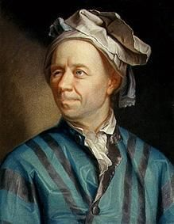
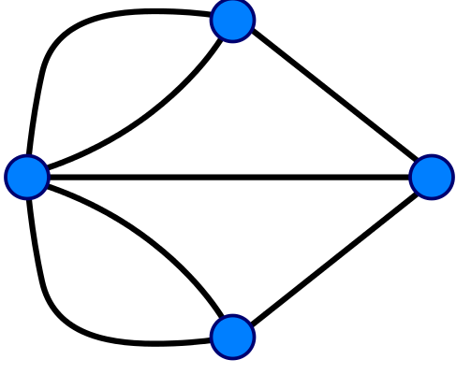
How to Solve
Brute Force?
Euler's Solution
Redraw the map as a graph (really a multigraph)
a
b
d
c

Slide 6
Euler's Proposal
A connected graph has an Euler tour (possible to cross each edge only once while traversing each edge only once and returning to starting point) if and only if every vertex has an even number of edges
Eulerian Circuit
What if we reduce the problem to only crossing each edge (bridge) exactly once?
Doesn't matter if we end up where we started
Eulerian Trail

Slide 7
Graph Definitions
A graph is comprised of a set of vertices (nodes) and a set of edges (links, arcs) connecting the vertices
in a directed graph edges are one-way
movement allowed from first node to second, but not second to first
directed graphs also called digraphs
in an undirected graph edges are two-way
movement allowed in either direction

Slide 8
Definitions
In a weighted graph the edge has cost or weight that measures the cost of traveling along the edge
A path is a sequence of vertices connected by edges
The path length is the number of edges
The weighted path length is the sum of the cost of the edges in a path
A cycle is a path of length 1 or more that starts and ends at the same vertex
a directed acyclic graph is a directed graph with no cycles

Slide 9
Graphs We've Seen
link
link
link
link
19
12
35
3
16
21
56
link
link
link

Slide 10
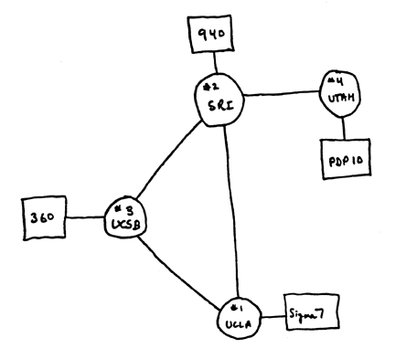
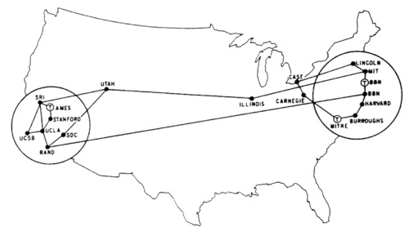
Example Graph
Computer Scientists use graphs to model all kinds of things
Arpanet 1969, 1971

Slide 11
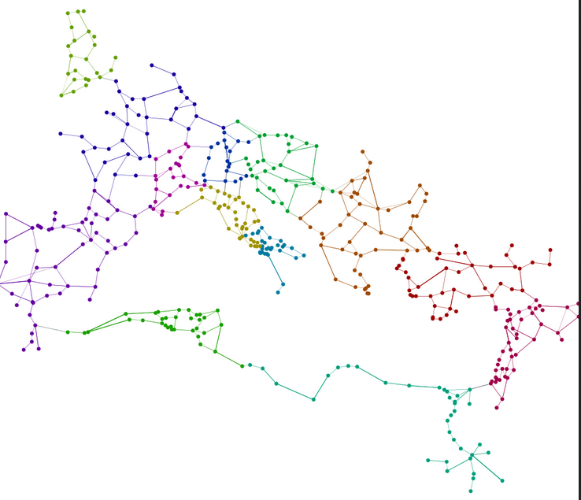
Example Graph
Roman Land Transportation
Network

Slide 12
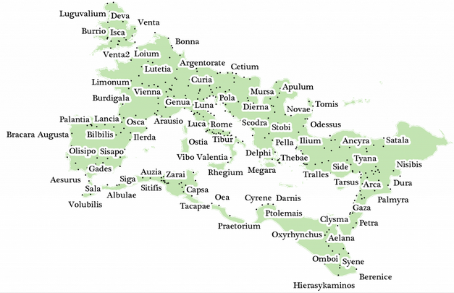
Roman Land Transportation Network

Slide 13
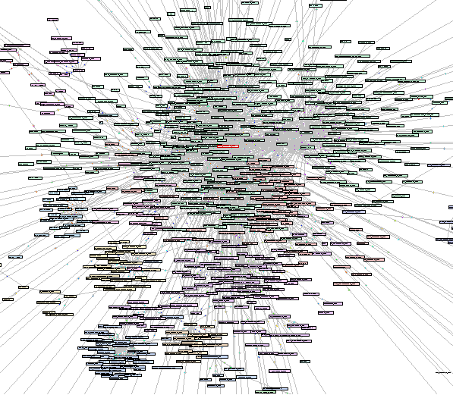
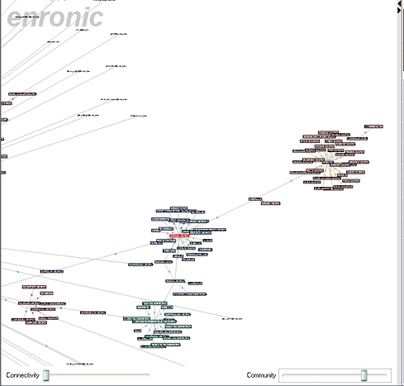
Example Graph
Enron emails 2001

Slide 14
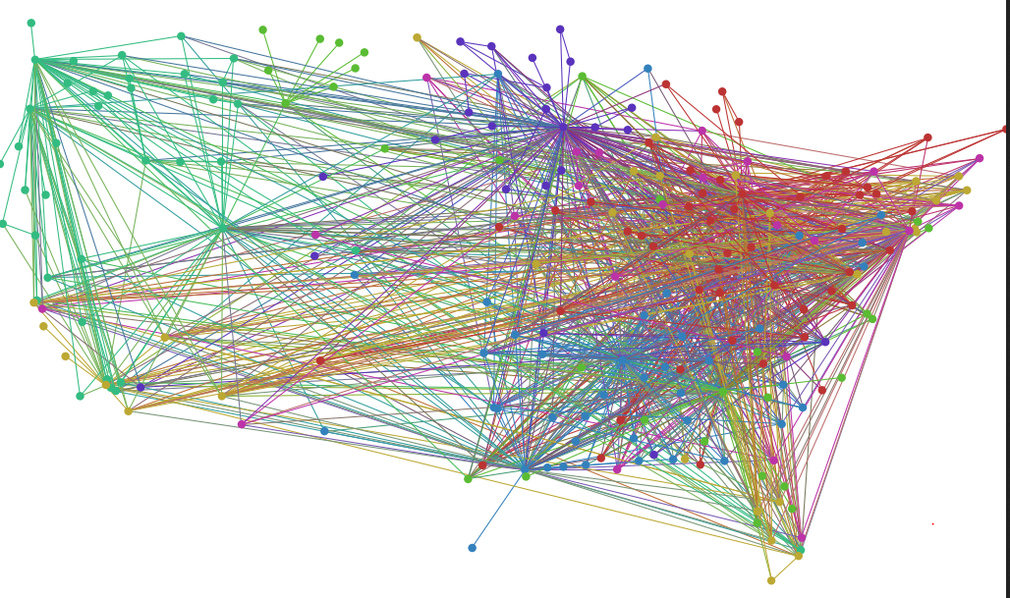
Example Graph
US Airport Network

Slide 15
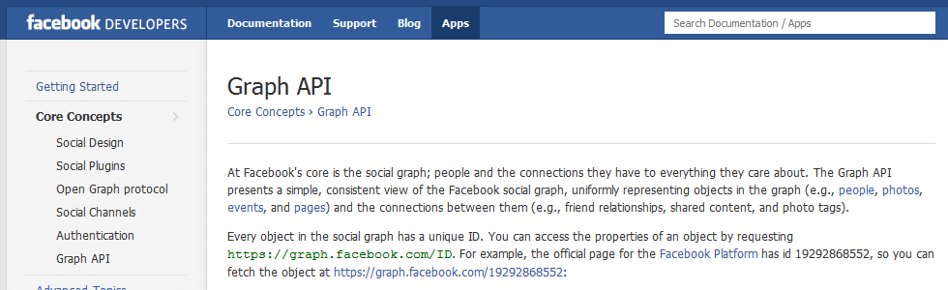
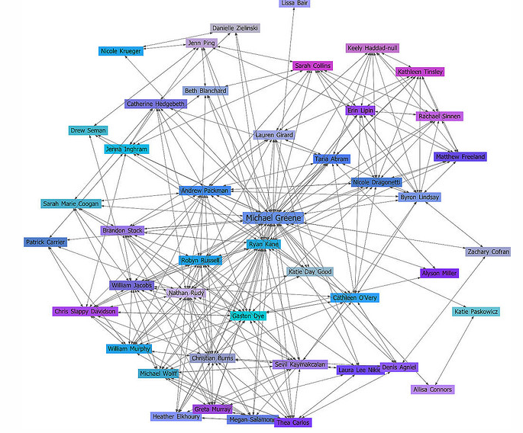
Example Graph

Slide 16
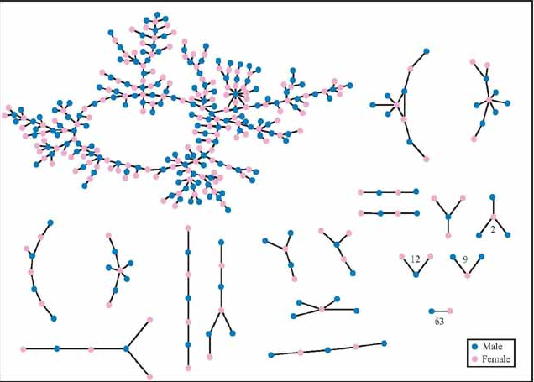
Example Graph
"Jefferson" High School, Ohio Chains of Affection: The Structure of Adolescent Romantic and Sexual Networks, 2005,

Slide 17
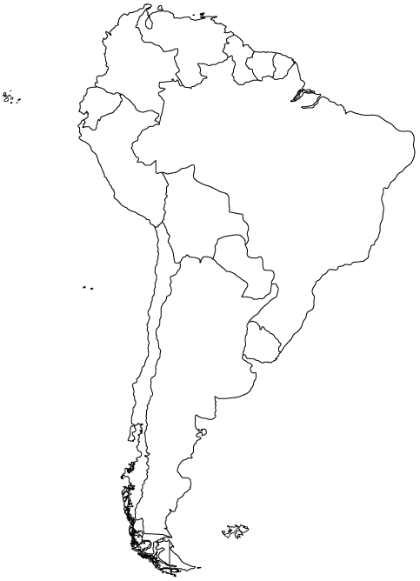
Representing Graphs
How to store a graph as a data structure?

Slide 18
Adjacency Matrix Representation
A Br Bl Ch Co E FG G Pa Pe S U V A 0 1 1 1 0 0 0 0 1 0 0 1 0 Br 1 0 1 0 1 0 1 1 1 1 1 1 1 Bl 1 1 0 1 0 0 0 0 1 1 0 0 0 Ch 1 0 1 0 0 0 0 0 0 1 0 0 0 Co 0 1 0 0 0 1 0 0 0 1 0 0 1 E 0 0 0 0 1 0 0 0 0 1 0 0 0 FG 0 1 0 0 0 0 0 0 0 0 1 0 0 G 0 1 0 0 0 0 0 0 0 0 1 0 1 Pa 1 1 1 0 0 0 0 0 0 0 0 0 0 Pe 0 1 1 1 1 1 0 0 0 0 0 0 0 S 0 1 0 0 0 0 1 1 0 0 0 0 0 U 1 1 0 0 0 0 0 0 0 0 0 0 0 V 0 1 0 0 1 0 0 1 0 0 0 0 0
Country
Code
Argentina
A
Brazil
Br
Bolivia
Bl
Chile
Ch
Columbia
Co
Ecuador
E
French Guiana
FG
Guyana
G
Paraguay
Pa
Peru
Pe
Suriname
S
Uruguay
U
Venezuela
V

Slide 19
The Map Coloring Problem
How many colors do you need to color a map, so that no 2 countries that have a common border (not a point) are colored the same?
How to solve using Brute Force?

Slide 20
A Solution
Blue
Blue
Yellow
Yellow
Green
Blue
Green
Yellow
Red
Green
Blue
Yellow

Slide 21
What About the Ocean?
A Br Bl Ch Co E FG G Pa Pe S U V Oc A 0 1 1 1 0 0 0 0 1 0 0 1 0 1 Br 1 0 1 0 1 0 1 1 1 1 1 1 1 1 Bl 1 1 0 1 0 0 0 0 1 1 0 0 0 0 Ch 1 0 1 0 0 0 0 0 0 1 0 0 0 1 Co 0 1 0 0 0 1 0 0 0 1 0 0 1 1 E 0 0 0 0 1 0 0 0 0 1 0 0 0 1 FG 0 1 0 0 0 0 0 0 0 0 1 0 0 1 G 0 1 0 0 0 0 0 0 0 0 1 0 1 1 Pa 1 1 1 0 0 0 0 0 0 0 0 0 0 0 Pe 0 1 1 1 1 1 0 0 0 0 0 0 0 1 S 0 1 0 0 0 0 1 1 0 0 0 0 0 1 U 1 1 0 0 0 0 0 0 0 0 0 0 0 1 V 0 1 0 0 1 0 0 1 0 0 0 0 0 1 Oc 1 1 0 1 1 1 1 1 0 1 1 1 1 0

Slide 22
Make the Ocean Blue
Red
Yellow
Yellow
Red
Green
Red
Green
Yellow
Blue
Blue
Green
Red
Blue
Yellow

Slide 23
More Definitions
A dense graph is one with a large number of edges
maximum number of edges?
A sparse graph is one in which the number of edges is much less than the maximum possible number of edges
No standard cutoff for dense and sparse graphs

Slide 24
Graph Representation
For dense graphs the adjacency matrix is a reasonable choice
For weighted graphs change booleans to cost
Can the adjacency matrix handle directed graphs?
Most graphs are sparse, not dense
For sparse graphs an adjacency list is an alternative that uses less space
Each vertex keeps a list of vertices it is connected to.

Slide 25
Graph Implementation
public class Graph
private static final double INFINITY = Double.MAX_VALUE;
private Map<String, Vertex> vertices;
public Graph() // create empty Graph
public void addEdge(String source,
String dest, double cost)
// find all paths from given vertex
public void findUnweightedShortestPath
(String startName)
// called after findUnweightedShortestPath
public void printPath(String destName)

Slide 26
Graph Class
This Graph class stores vertices
Each vertex has an adjacency list
what vertices does it connect to?
shortest path method finds all paths from start vertex to every other vertex in graph
after shortest path method called queries can be made for path length from start node to destination node

Slide 27
Vertex Class (nested in Graph)
private static class Vertex
private String name;
private List<Edge> adjacent;
public Vertex(String n)
// for shortest path algorithms
private double distance;
private Vertex prev;
private int scratch;
// call before finding new paths
public void reset()

Slide 28
Edge Class (nested in Graph)
private static class Edge
private Vertex dest;
private double cost;
private Edge(Vertex d, double c)

Slide 29
Unweighted Shortest Path
Given a vertex, S (for start) find the shortest path from S to all other vertices in the graph
Graph is unweighted (set all edge costs to 1)
V₇
V₁
S
V₆
V₂
V₄
V₈
V₃
V₅

Slide 30
Word Ladders
Agree upon dictionary
Start word and end word of same length
Change one letter at a time to form step
Step must also be a word
Example: Start = silly, end = funny
silly
sully
sulky
hulky
hunky
funky
funny

Slide 31
Graph Representation
What are the vertices and when does an edge exist between two vertices?
Vertices Edges
Letters Words
Words Words that share one or more letters
Letters Words that share one or more letters
Words Words that differ by one letter
Words Letters

Slide 32
smarm
swart
smart
start
smalt
scart
Portion of Graph

Slide 33
Size of Graph
Number of vertices and edges depends on dictionary
Modified Scrabble dictionary, 5 letter words
Words are vertices
8660 words
Edge exists between word if they are one letter different
24,942 edges
Is this graph sparse or dense?
Sparse
Dense
Max number of edges = N * (N - 1) / 2 37,493,470

Slide 34
Unweighted Shortest Path Algorithm
Problem: Find the shortest word ladder between two words if one exists
What kind of search should we use?
Breadth First Search
Depth First Search
Either one

Slide 35
Unweighted Shortest Path Algorithm
Set distance of start to itself to 0
Create a queue and add the start vertex
while the queue is not empty
remove front
loop through all edges of current vertex
get node edge connects to
if this node has not been visited
sets its distance to current distance + 1
sets its previous node to current node
add new node to queue

Slide 36
smarm
swart
smart
start
smalt
scart
Portion of Graph

Slide 37
smarm
swart
smart
start
smalt
scart
Start at "smart" and enqueue it [smart]

Slide 38
smarm
swart
smart
start
smalt
scart
Dequeue (smart), loop through edges
[swart]

Slide 39
smarm
swart
smart
start
smalt
scart
Dequeue (smart), loop through edges
[swart, start]

Slide 40
smarm
swart
smart
start
smalt
scart
Dequeue (smart), loop through edges
[swart, start, scart]

Slide 41
smarm
swart
smart
start
smalt
scart
Dequeue (smart), loop through edges
[swart, start, scart, smalt]

Slide 42
smarm
swart
smart
start
smalt
scart
Dequeue (smart), loop through edges
[swart, start, scart, smalt, smarm]

Slide 43
smarm
swart
smart
start
smalt
scart
Done with smart, dequeue (swart)
[start, scart, smalt, smarm]

Slide 44
smarm
swart
smart
start
smalt
scart
loop through edges of swart (start already present)
[start, scart, smalt, smarm]

Slide 45
smarm
swart
smart
start
smalt
scart
loop through edges of swart (scart already present)
[start, scart, smalt, smarm]

Slide 46
smarm
swart
smart
swarm
start
smalt
scart
loop through edges of swart
[start, scart, smalt, smarm, swarm]

Slide 47
smarm
sware
swart
smart
swarm
start
smalt
scart
loop through edges of swart
[start, scart, smalt, smarm, swarm, sware]

Slide 48
Unweighted Shortest Path
Implement method
demo
how is path printed?
The diameter of a graph is the longest shortest past in the graph
How to find?
How to find center of graph?
vertex connected to the largest number of other vertices with the shortest average path length

Slide 49
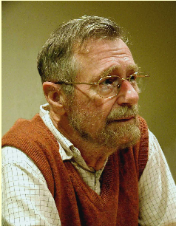
Positive Weighted Shortest Path
Edges in graph are weighted and all weights are positive
Similar solution to unweighted shortest path
Dijkstra's algorithhm
Edsger W. Dijkstra (1930–2002)
UT Professor 1984 - 2000
Algorithm developed in 1956 and published in 1959.

Slide 50
Dijkstra's Algorithm
Pick the start vertex
Set the cost of the start vertex to 0 and all other vertices to INFINITY
While there are unvisited vertices:
Let the current vertex be the lowest cost vertex that has not yet been visited
mark current vertex as visited
for each edge from the current vertex
if the sum of the cost of the current vertex and the cost of the edge is less than the cost of the destination vertex
update the cost of the destination vertex
set the previous of the destination vertex to the current vertex

Slide 51
Dijkstra's Algorithm
Example of a Greedy Algorithm
A Greedy Algorithm does what appears to be the best thing at each stage of solving a problem
Gives best solution in Dijkstra's Algorithm
Does NOT always lead to best answer
Fair teams:
(10, 10, 8, 8, 8), 2 teams
Making change with fewest coins
(1, 5, 10) 15 cents
(1, 5, 12) 15 cents

Slide 52
7
C
3
3
F
4
B
21
1
D
6
A
E
17
5
G
What is the lowest cost path from A to E?
3
17
20
28
37

Slide 53
7
C
3
3
F
4
B
21
1
D
6
A
E
17
5
G
A is start vertex
Set cost of A to 0, all others to INFINITY
Place A in a priority queue

Slide 54
7
C
3
3
F
4
B
21
1
D
6
A
E
17
5
G
[(A,0)] pq
dequeue (A,0)
Mark A as visited

Slide 55
7
C
3
3
F
4
B
21
1
D
6
A
E
17
5
[ ] pq
current vertex A:
loop through A's edges
if sum of cost from A to edge is less than current cost
update cost and prev
G

Slide 56
7
C
3
3
F
4
B
21
1
D
6
A
E
17
5
[ ] pq
A -> B, 0 + 1 < INFINITY
[(B,1)] pq
G

Slide 57
7
C
3
3
F
4
B
21
1
D
6
A
E
17
5
[(B,1)] pq
A -> C, 0 + 7 < INFINITY
[(B,1), (C, 7)] pq
G

Slide 58
7
C
3
3
F
4
B
21
1
D
6
A
E
17
5
[(B,1), (C, 7)] pq
A -> G, 0 + 17 < INFINITY
[(B,1), (C, 7), (G, 17)] pq
G

Slide 59
7
C
3
3
F
4
B
21
1
D
6
A
E
17
5
[(B,1), (C, 7), (G, 17)] pq
current vertex B:
loop through B's edges
if sum of cost from B to edge is less than current cost
update cost and prev
G

Slide 60
7
C
3
3
F
4
B
21
1
D
6
A
E
17
5
[(C, 7), (G, 17)] pq
B -> C, 1 + 3 < 7
update C's cost and previous
[(C, 4), (C, 7), (G, 17)] pq
G

Slide 61
7
C
3
3
F
4
B
21
1
D
6
A
E
17
5
G
[(C, 4), (C, 7), (G, 17)] pq
B -> D, 1 + 21 < INFINITY
[(C, 4), (C, 7), (G, 17), (D, 22)] pq

Slide 62
7
C
3
3
F
4
B
21
1
D
6
A
E
17
5
G
[(C, 4), (C, 7), (G, 17), (D, 22)] pq
current vertex is C, cost 4
loop through C's edges

Slide 63
7
C
3
3
F
4
B
21
1
D
6
A
E
17
5
G
[(C, 7), (G, 17), (D, 22)] pq
C -> A, A already visited so skip

Slide 64
7
C
3
3
F
4
B
21
1
D
6
A
E
17
5
G
[(C, 7), (G, 17), (D, 22)] pq
C -> B, B already visited so skip

Slide 65
7
C
3
3
F
4
B
21
1
D
6
A
E
17
5
G
[(C, 7), (G, 17), (D, 22)] pq
C -> F, 4 + 3 < INFINITY
[(C, 7), (F, 7), (G, 17), (D, 22)] pq

Slide 66
7
C
3
3
F
4
B
21
1
D
6
A
E
17
5
G
[(C, 7), (F, 7), (G, 17), (D, 22)] pq
current vertex is C
Already visited so skip

Slide 67
7
C
3
3
F
4
B
21
1
D
6
A
E
17
5
G
[(F, 7), (G, 17), (D, 22)] pq
current vertex is F
loop through F's edges

Slide 68
7
C
3
3
F
4
B
21
1
D
6
A
E
17
5
G
[(G, 17), (D, 22)] pq
F -> C, already visited so skip

Slide 69
7
C
3
3
F
4
B
21
1
D
6
A
E
17
5
[(G, 17), (D, 22)] pq
F -> D, 7 + 4 < 22
update D's cost and previous
[(D, 11), (G, 17), (D, 22)] pq
G

Slide 70
7
C
3
3
F
4
B
21
1
D
6
A
E
17
5
G
[(D, 11), (G, 17), (D, 22)] pq
current vertex is D
loop through D's edges

Slide 71
7
C
3
3
F
4
B
21
1
D
6
A
E
17
5
G
[(G, 17), (D, 22)] pq
D -> B, already visited so skip

Slide 72
7
C
3
3
F
4
B
21
1
D
6
A
E
17
5
G
[(G, 17), (D, 22)] pq
D -> E, 11 + 6 < INFINITY
update E's cost and previous
[(G, 17), (E, 17), (D, 22)] pq

Slide 73
7
C
3
3
F
4
B
21
1
D
6
A
E
17
5
G
[ (G, 17), (E, 17), (D, 22)] pq
D -> F, already visited so skip

Slide 74
7
C
3
3
F
4
B
21
1
D
6
A
E
17
5
G
[(G, 17), (E, 17), (D, 22)] pq
D -> G, 11 + 5 < 17
update G's cost and previous
[(G, 16), (G, 17), (E, 17), (D, 22)] pq

Slide 75
7
C
3
3
F
4
B
21
1
D
6
A
E
17
5
G
[(G, 17), (E, 17), (D, 22)] pq
current vertex is G
loop though edges, already visited all neighbors

Slide 76
7
C
3
3
F
4
B
21
1
D
6
A
E
17
5
G
[(E, 17), (D, 22)] pq
current vertex is E
loop though edges, already visited all neighbors

Slide 77
7
C
3
3
F
4
B
21
1
D
6
A
E
17
5
G
No unvisited vertices.
Done.

Slide 78
Implementing Dijkstra's
Create a Path class to allow for multiple distances to a given vertex
private static class Path
implements Comparable<Path> {
private Vertex dest;
private double cost;
Use a priority queue of Paths to store the vertices and distances

Slide 79
Alternatives to Dijkstra's Algorithm
A*, pronounced "A Star"
A heuristic, goal of finding shortest weighted path from single start vertex to goal vertex
Uses actual distance like Dijkstra's but also estimates remaining cost or distance
distance is set to current distance from start PLUS the estimated distance to the goal
For example when finding a path between towns, estimate the remaining distance as the straight-line (as the crow files) distance between current location and goal.

Slide 80
Spanning Tree
Spanning Tree: A tree of edges that connects all the vertices in a graph
7
C
3
3
F
4
B
21
1
D
6
A
E
17
5
G

Slide 81
Minimum Spanning Tree
Minimum Spanning Tree: A spanning tree in a weighted graph with the lowest total cost
used in network design, taxonomy, Image registration, and more!
Cost of spanning tree shown? A. 6
B. 7 C. 29 D. 61
E. None of These
7
C
3
3
F
4
B
21
1
D
6
A
E
17
5
G

Slide 82
Prim's Algorithm
Pick a vertex arbitrarily from graph
In other words, it doesn't matter which one
Add lowest cost edge between the tree and a vertex that is not part of the tree UNTIL every vertex is part of the tree
Greedy Algorithm, very similar to Dijkstra's

Slide 83
Prim's Algorithm
2
A
B
4
11
3
2
C
D
E
2
7
8
4
6
5
F
G
1
Pick D as root

Slide 84
Prim's Algorithm
2
A
B
4
11
3
2
C
D
E
2
7
8
4
6
5
F
G
1
Lowest cost edge from tree to vertex not in Tree? 2 from D to A (or C)

Slide 85
Prim's Algorithm
2
A
B
4
11
3
2
C
D
E
2
7
8
4
6
5
F
G
1
Lowest cost edge from tree to vertex not in Tree? 2 from D to C (OR from A o B)

Slide 86
Prim's Algorithm
2
A
B
4
11
3
2
C
D
E
2
7
8
4
6
5
F
G
1
Lowest cost edge from tree to vertex not in Tree? 2 from A to B

Slide 87
Prim's Algorithm
2
A
B
4
11
3
2
C
D
E
2
7
8
4
6
5
F
G
1
Lowest cost edge from tree to vertex not in Tree? 5 from D to G

Slide 88
Prim's Algorithm
2
A
B
4
11
3
2
C
D
E
2
7
8
4
6
5
F
G
1
Lowest cost edge from tree to vertex not in Tree? 1 from G to F

Slide 89
Prim's Algorithm
2
A
B
4
11
3
2
C
D
E
2
7
8
4
6
5
F
G
1
Lowest cost edge from tree to vertex not in Tree? 6 from G to E

Slide 90
Prim's Algorithm
7
C
3
3
F
4
B
21
1
D
6
A
E
17
5
G
Pick D as root

Slide 91
Prim's Algorithm
7
C
3
3
F
4
B
21
1
D
6
A
E
17
5
G
Lowest cost edge from tree to vertex not in Tree? 4 from D to F

Slide 92
Prim's Algorithm
7
C
3
3
F
4
B
21
1
D
6
A
E
17
5
G
Lowest cost edge from tree to vertex not in Tree?
3 from F to C

Slide 93
Prim's Algorithm
7
C
3
3
F
4
B
21
1
D
6
A
E
17
5
G
Lowest cost edge from tree to vertex not in Tree?
3 from C to B

Slide 94
Prim's Algorithm
7
C
3
3
F
4
B
21
1
D
6
A
E
17
5
G
Lowest cost edge from tree to vertex not in Tree?
1 from B to A

Slide 95
Prim's Algorithm
7
C
3
3
F
4
B
21
1
D
6
A
E
17
5
G
Lowest cost edge from tree to vertex not in Tree?
5 from D to G

Slide 96
Prim's Algorithm
7
C
3
3
F
4
B
21
1
D
6
A
E
17
5
G
Lowest cost edge from tree to vertex not in Tree?
6 from D to E

Slide 97
Prim's Algorithm
7
C
3
3
F
4
B
21
1
D
6
A
E
17
5
G
Cost of Spanning Tree?

Slide 98
Other Graph Algorithms
Lots!
http://en.wikipedia.org/wiki/Category:Graph_algorithms

